Slide 1
Georgia School Categorization through Covid

Slide 2
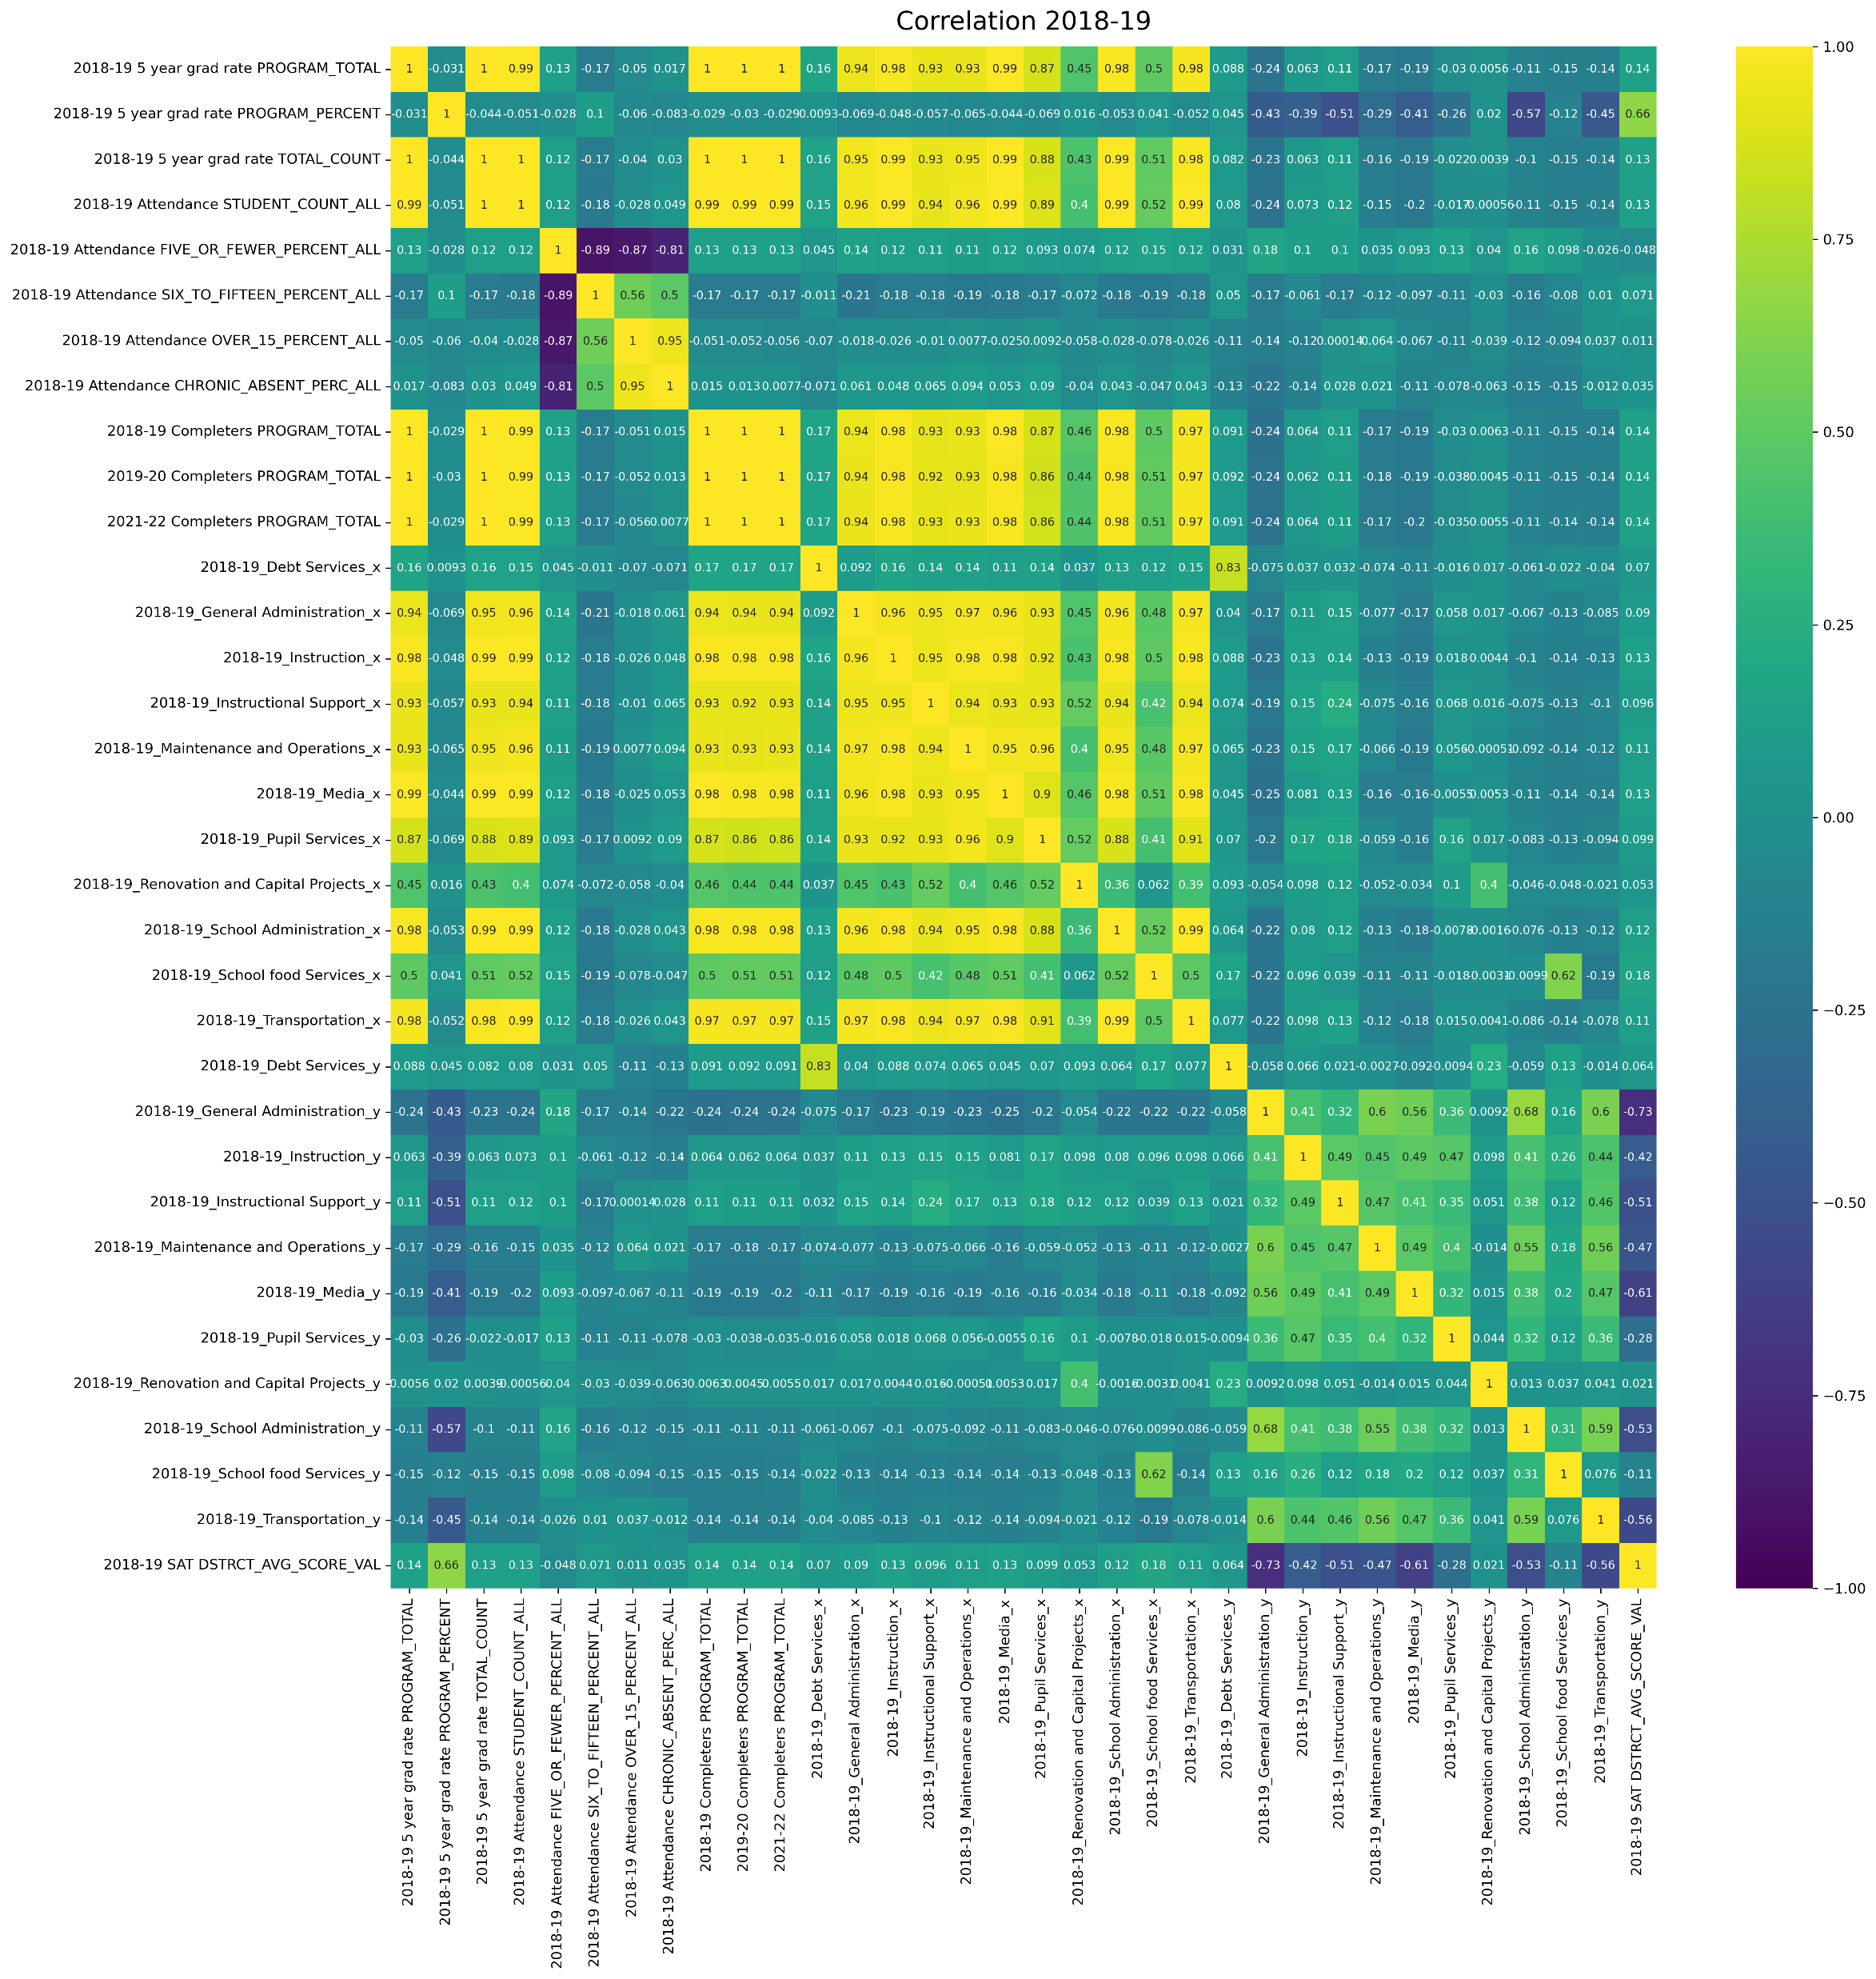

Slide 3
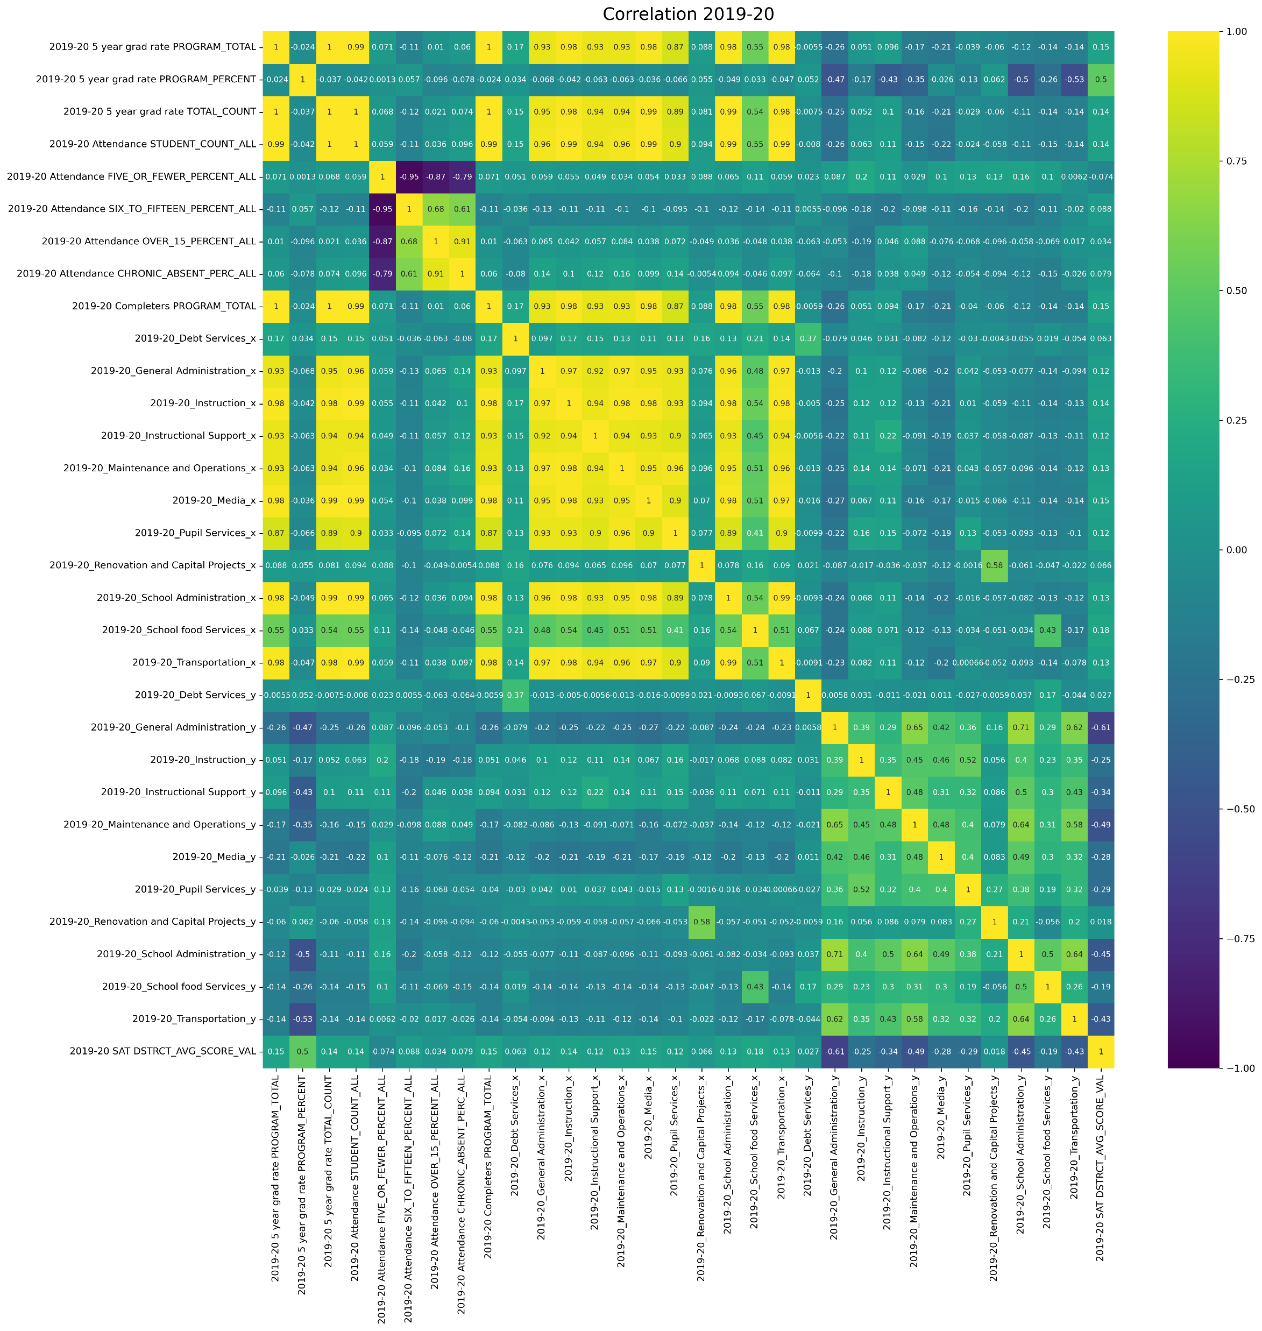

Slide 4
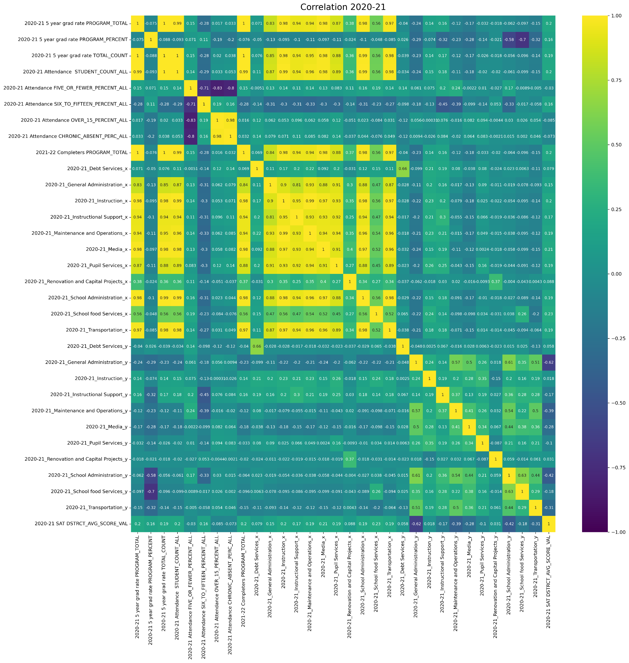

Slide 5
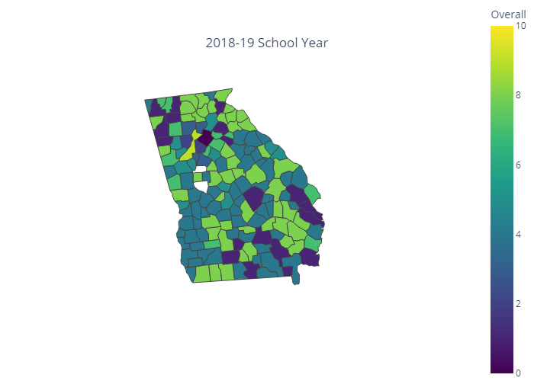
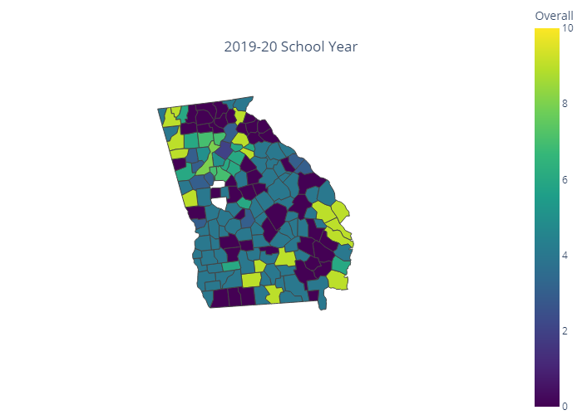
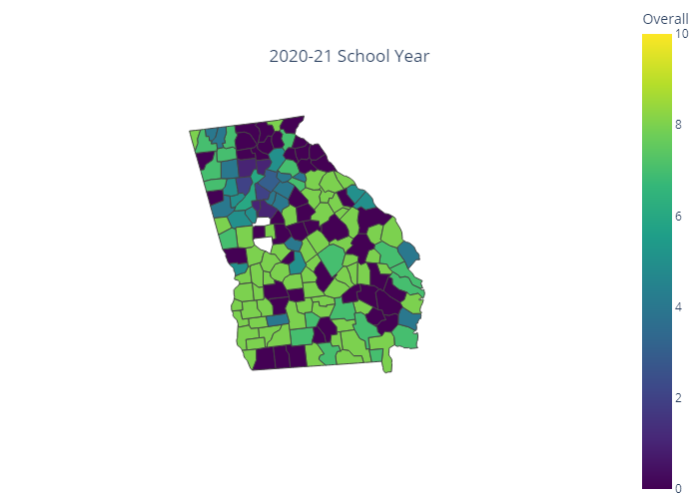
Overall cluster labeling with performance
The differences between counties were centered on primarily metro areas in 2018-19 and decreased in 2019-20 which included the start of the pandemic. In 2020-21 as schools reopened differences increased primarily in southern Georgia.

Slide 6
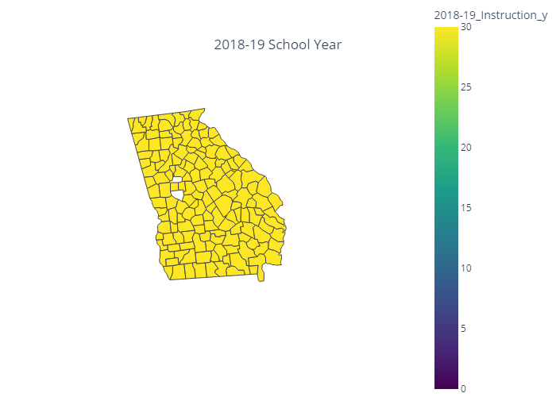


Instruction expenditures
No appreciable difference in SAT scores but scaling the data for instructional expenditures and SAT scores might illuminate variances.

Slide 7
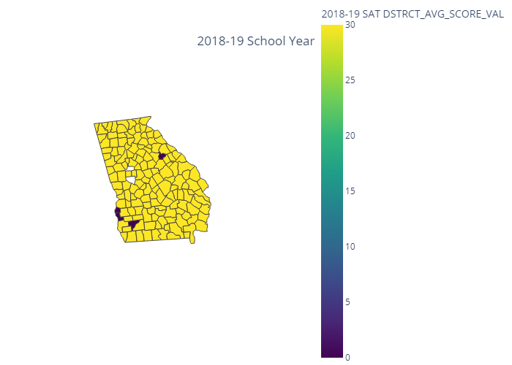
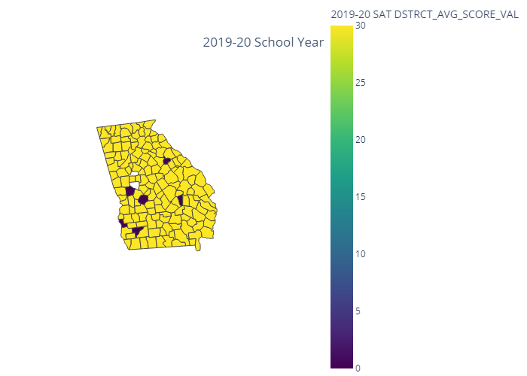
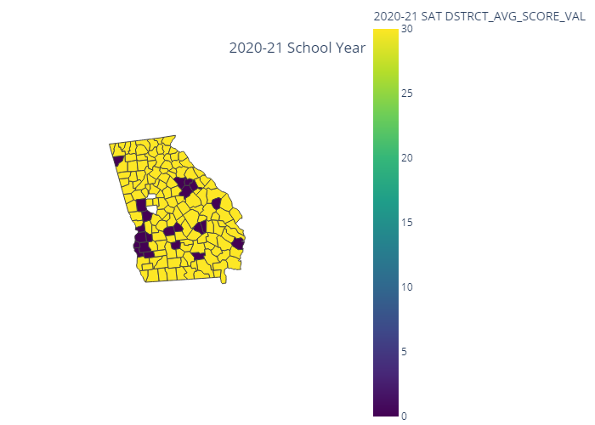
SAT Combined Score
SAT scored decreased in certain areas like Columbus, Macon, Savannah, and Athens through the years but the students taking it in 2020-21 had their junior year most affected by Covid and it’s been said that the junior year is critical.

Slide 8
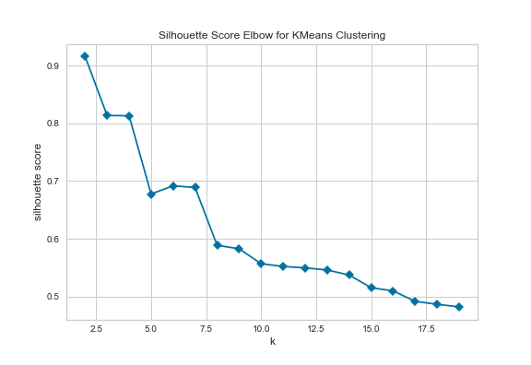
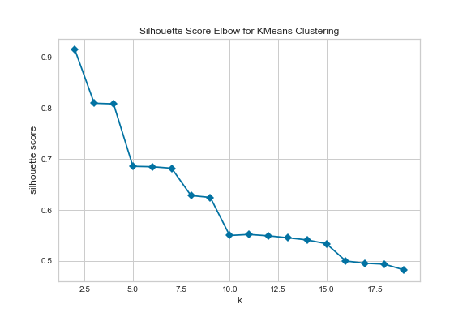
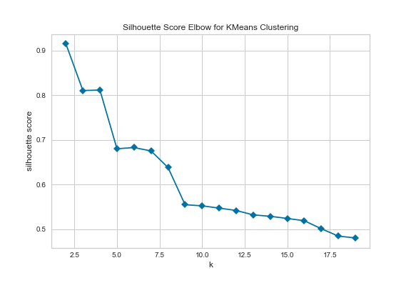
2018-19 silhouette scores
2019-20 silhouette scores
2020-21 silhouette scores
The elbow was selected at 10 clusters for each school year

